Slide 1
WEB APPLICATION DEVELOPMENT TRAINING
SQL STATEMENTS – INSERT, SELECT DELETE and UPDATE

Slide 2
DROP, TRUNCATE
To empty a database table, use the TRUNCATE statement.
Syntax is : TRUNCATE table_name;
To Delete the entire table (no remedy!) use the DROP statement. Syntax is:
DROP table table_name

Slide 3
AUTO INCREMENT AND RESET
When you delete one or more records from a table, if there is an auto field, the increment value continues from the last record.
You can reset the auto increment before adding new records.
To do this in HeidiSQL, see the next slide:
Change the auto increment value to the desired number

Slide 4
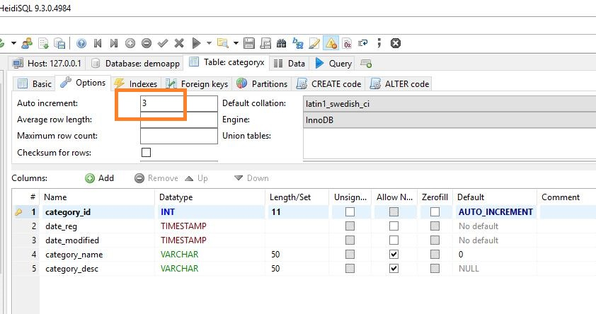

Slide 5
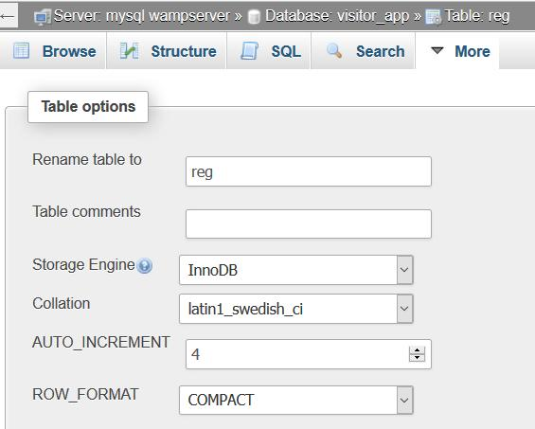

Slide 6
The INSERT Statement
The INSERT statement is used to add new data (record) to a database table.
There are 3 formats, The first does not specify the column names where the data will be inserted, only their values while the second specifies both column names and values:
INSERT INTO table_name
VALUES (‘value1’,’value2’,’value3’...);
INSERT INTO table_name (column1,column2,column3,...)
VALUES (‘value1’,’value2’,’value3’...);
INSERT INTO table_name SET column1 =‘value1’,
  Column2=‘value2’
Notes:
For the first one, the total values must match the numbers of columns in the table
With the second method, it is possible to add data to only specified columns on the table

Slide 7
Exercise
Insert 3 records using each of the formats in the previous slide
The auto increment value can be left empty or 0 , it will automatically make use of the next auto increment integer

Slide 8
Exercise
Using the first form of INSERT Statement described above, add 3 customers’ record the Customer Table you just created. Two of your customers are residing in Lagos State
Using the second form of INSERT statement described above, add 4 Records to the Product Table you just created.
How does your database look like when viewed from HeidiSQL?
Assignment: Create tables in your db, student, dept, faculty and populate

Slide 9
The SELECT Statements
The SELECT statement is used to select data from a database.
The result is stored in a result table, called the result-set. This is an imaginary table in the memory
Syntax:
SELECT column_name,column_name
FROM table_name;
SELECT * FROM table_name;
Exercise: Using The Select Statement, select all the data from your product table, select only price and product name

Slide 10
SQL Aliases – SELECT AS
To select from tables by adding your own custom headings.
Exercise: You have earlier complained that the previous development team that designed the student portal in the university where you work didn’t use appropriate column name for the fields. The VC has requested for a report of all the students in the school.
Generate this list by using your own custom heading

Slide 11
SQL Aliases – SELECT AS
SQL aliases are used to temporarily rename a table or a column heading.
SELECT column_name AS ‘alias_name’
FROM table_name;
SELECT column_name(s)
FROM table_name AS alias_name;
SELECT cust_lname AS ‘Name' FROM customers
You can use the aliase method to concatenate columns and select under one heading using the concat statement
SELECT concat (cust_fname," ",cust_lname) AS 'info' FROM customers

Slide 12
ORDER BY Clauses
The SQL ORDER BY clause is used to sort the data in ascending or descending order, based on one or more columns.
The Syntax is: SELECT column-list FROM table_name [WHERE condition] [ORDER BY column1, column2, .. columnN] [ASC | DESC];
You can use more than one column in the ORDER BY clause
Notes:
Some database sorts query results in ascending order by default.

Slide 13
The SQL WHERE Clause
The WHERE clause is used to extract only those records that fulfill a specified criterion.
SELECT column_name,column_name
FROM table_name
WHERE column_name operator value;
SQL requires single quotes around text values (most database systems will also allow double quotes).
However, numeric fields should not be enclosed in quotes:
Exercise: Select only products whose prices are more than 1,000 naira

Slide 14
The SQL SELECT DISTINCT Statement
In a table, a column may contain many duplicate values; and sometimes you only want to list the different (distinct) values.
The DISTINCT keyword can be used to return only distinct (different) values.
Syntax is SELECT DISTINCT column_name,column_name
FROM table_name;
Exercise: Using the SELECT Distinct Statement, Select all the customers living in distinct state

Slide 15
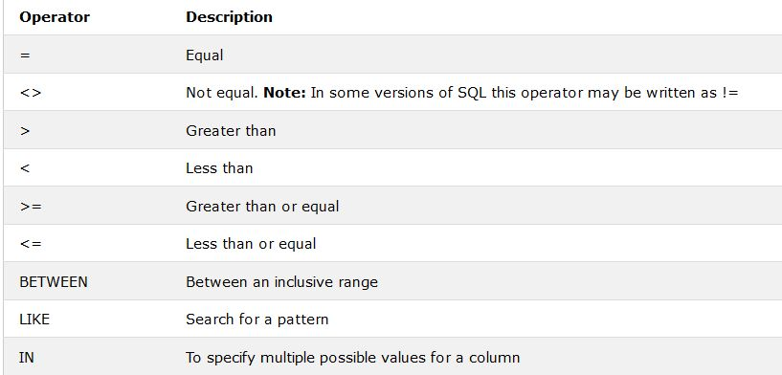
Operators and their Description

Slide 16
The SQL LIKE Clause
The SQL LIKE clause is used to compare a value to similar values using wildcard operators.
There are two wildcards used in conjunction with the LIKE operator
The percent sign (%)
The underscore (_)
A wildcard character can be used to substitute for any other character(s) in a string
The percent sign represents zero, one, or multiple “missing” characters.
The underscore represents a single number or character.
The symbols can be used in combinations.

Slide 17
The SQL LIKE Clause
The basic syntax of % and _ is as follows:
SELECT FROM table_name
WHERE column LIKE 'XXXX‘
XXXX can be preceded with % or _, it may also end with % or _

Slide 18
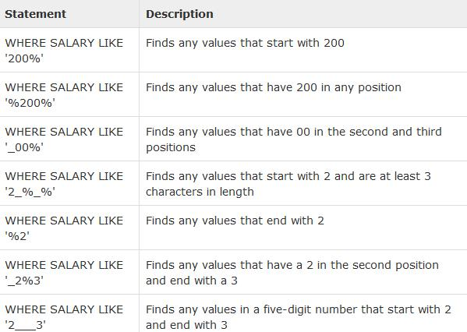
SQL LIKE Examples of Usage

Slide 19
SQL AND OPERATOR
The AND operator is used to filter records based on more than one condition
The AND operator displays a record if both the first condition AND the second condition are true.
Format is:
SELECT * FROM tablename
WHERE columname =‘value'
AND columname=‘value';
Notes:
* Is to select All

Slide 20
SQL OR OPERATOR
The OR operator displays a record if any of the conditions separated by OR is TRUE
Syntax is:
SELECT column1, column2, ...
FROM table_name
WHERE condition1 OR condition2 OR condition3 ...;

Slide 21
SQL BETWEEN OPERATOR
Syntax is as follows:
  SELECT column1, column2....columnN
  FROM table_name
  WHERE column_name BETWEEN val-1 AND val-2;

Slide 22
THE IN OPERATOR
The IN operator allows you to specify multiple values in a WHERE clause.
The syntax is: SELECT column_name(s)
FROM table_name
WHERE column_name IN (value1,value2,...);

Slide 23
EXPORTING AND IMPORTING
You are the database admin of GTB, all banks have been mandated by the CBN new policy to produce their customer list within 6 hours.
Do you think this will be a problem in a manual system, will they meet up with the deadline?
Is this deadline fair in an automated environment where relational db is in use?
Respond to this using PHPMyadmin and HeidiSQL

Slide 24
Class Exercise
Using the database given, write queries to generate the following results:
All customers who have an “a” in either their first name or last name
All customers who live in Lagos
All orders above 5,000 naira
All orders except the ids 1 and 4
Help the Manager get the phone number of a customer named ‘Tola Oni’ who lives in Ondo
Notes:
-- select cust_id, cust_fname,cust_lname from customers
-- select cust_id, cust_fname,cust_lname from customers where (cust_fname like '%a%' or cust_lname like '%a%')
-- select cust_id, cust_fname,cust_lname from customers where cust_city ='Lagos'
-- select * from customer_orders where custord_amt > 5000
-- select cust_id, cust_fname,cust_lname from customers where cust_id NOT IN (1,4)

Slide 25
Steps in Designing a Database
Database design is the process of producing a detailed data model of database
Decide on what data to store in the database
Determine the categories of related data and create tables accordingly. Each table should contain ONLY related data
For each column in the table, determine the appropriate data type.
Each table should contain a field that is unique to each record in the table
Exercise: create a database for the customer registration and product information aspect of an ecommerce website . Design the database in such a way that customers can search for items by product name and also by category

Slide 26
Logical Representation of a Database
The process of logical design involves arranging data into a series of logical relationships called entities and attributes
An entity relationship model, also called an entity-relationship (ER) diagram, is a graphical representation of entities and their relationships to each other, typically used in computing in regard to the organization of data within databases or information systems.

Slide 27
Database Entity
An entity is any object in the system that we want to model and store information about.
Entities are usually recognizable concepts, either concrete or abstract, such as customer, products which have relevance to the E-commerce website database.

Slide 28
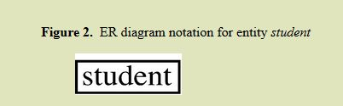
Logical Database Design Using Entity Relationship Diagram
You can design/model your database [tables] using Entity Relationship Diagram where the tables represent the entity you are modeling.
Each entity has attributes, or particular properties that describe the entity.
For example, student Emanuel has properties of his own Student Identification number

Slide 29
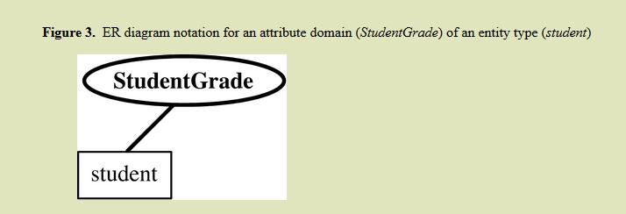
Logical Database Design Using Entity Relationship Diagram
The attributes of the entities are the columns of the database tables and are represented by ovals that connect to the entity

Slide 30
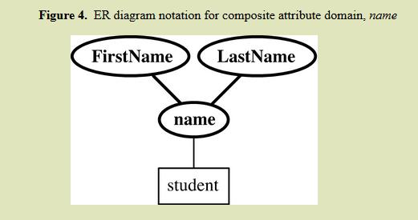
Logical Database Design Using Entity Relationship Diagram
A composite attribute is one that can have more than one part eg name can be first name and surname

Slide 31
Other Study Materials
https://www.w3schools.com/sql/default.asp

